Slide 1
Inclusion criteria
FND diagnosis confirmed and clearly communicated to patient by a neurologist (including functional movement/weakness/sensory/speech issues)
Medically stable and suitable to be seen in clinic / within their own homes
Patient consenting to referral, accepting of the diagnosis, engages in therapy and is NOT actively seeking alternative explanations for symptoms (i.e. alternative organic explanation).
  If during the course of rehabilitation, further medical investigations are pursued, then it may be necessary to pause treatment until these are completed.
Has clear therapeutic goals and is able to attend regular appointments
Able to engage in therapy and implement changes

Slide 2
Exclusion criteria
Non-epileptic seizures (if seen in isolation)
Mental health - we are unable to work with people showing signs of moderate / severe mental health problems (e.g. active suicidality or psychosis, personality disorder, PTSD). Detailed mental health history requested if possible as part of the assessment process.
Challenging behaviour - we cannot work with patients who display with challenging behaviour, such as aggression, sexually inappropriate behaviour, socially inappropriate behaviour, which is likely to significantly impact on their engagement.
Current alcohol/substance misuse which significantly impact on engagement
Where pain and fatigue are so severe that they are unable to engage in an active rehabilitation program.

Slide 3
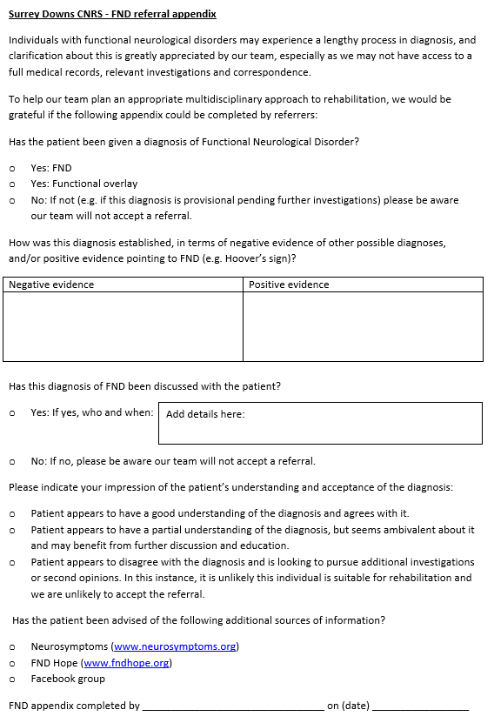
Referral
Appendix

Slide 4
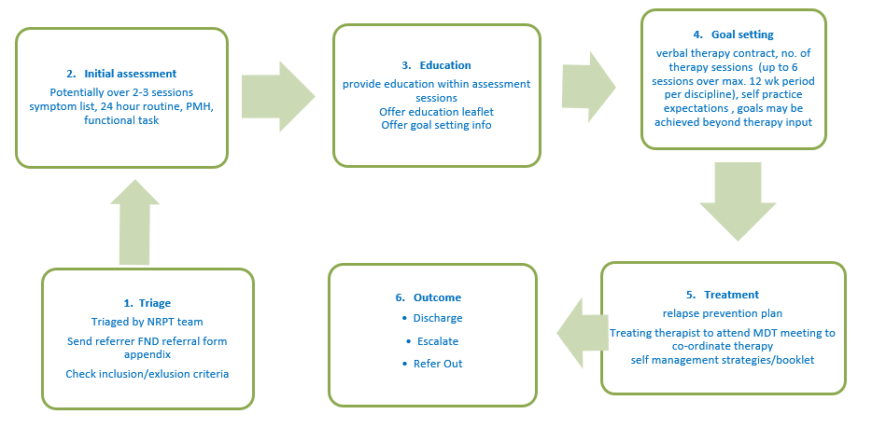
PATHWAY

